Slide 1
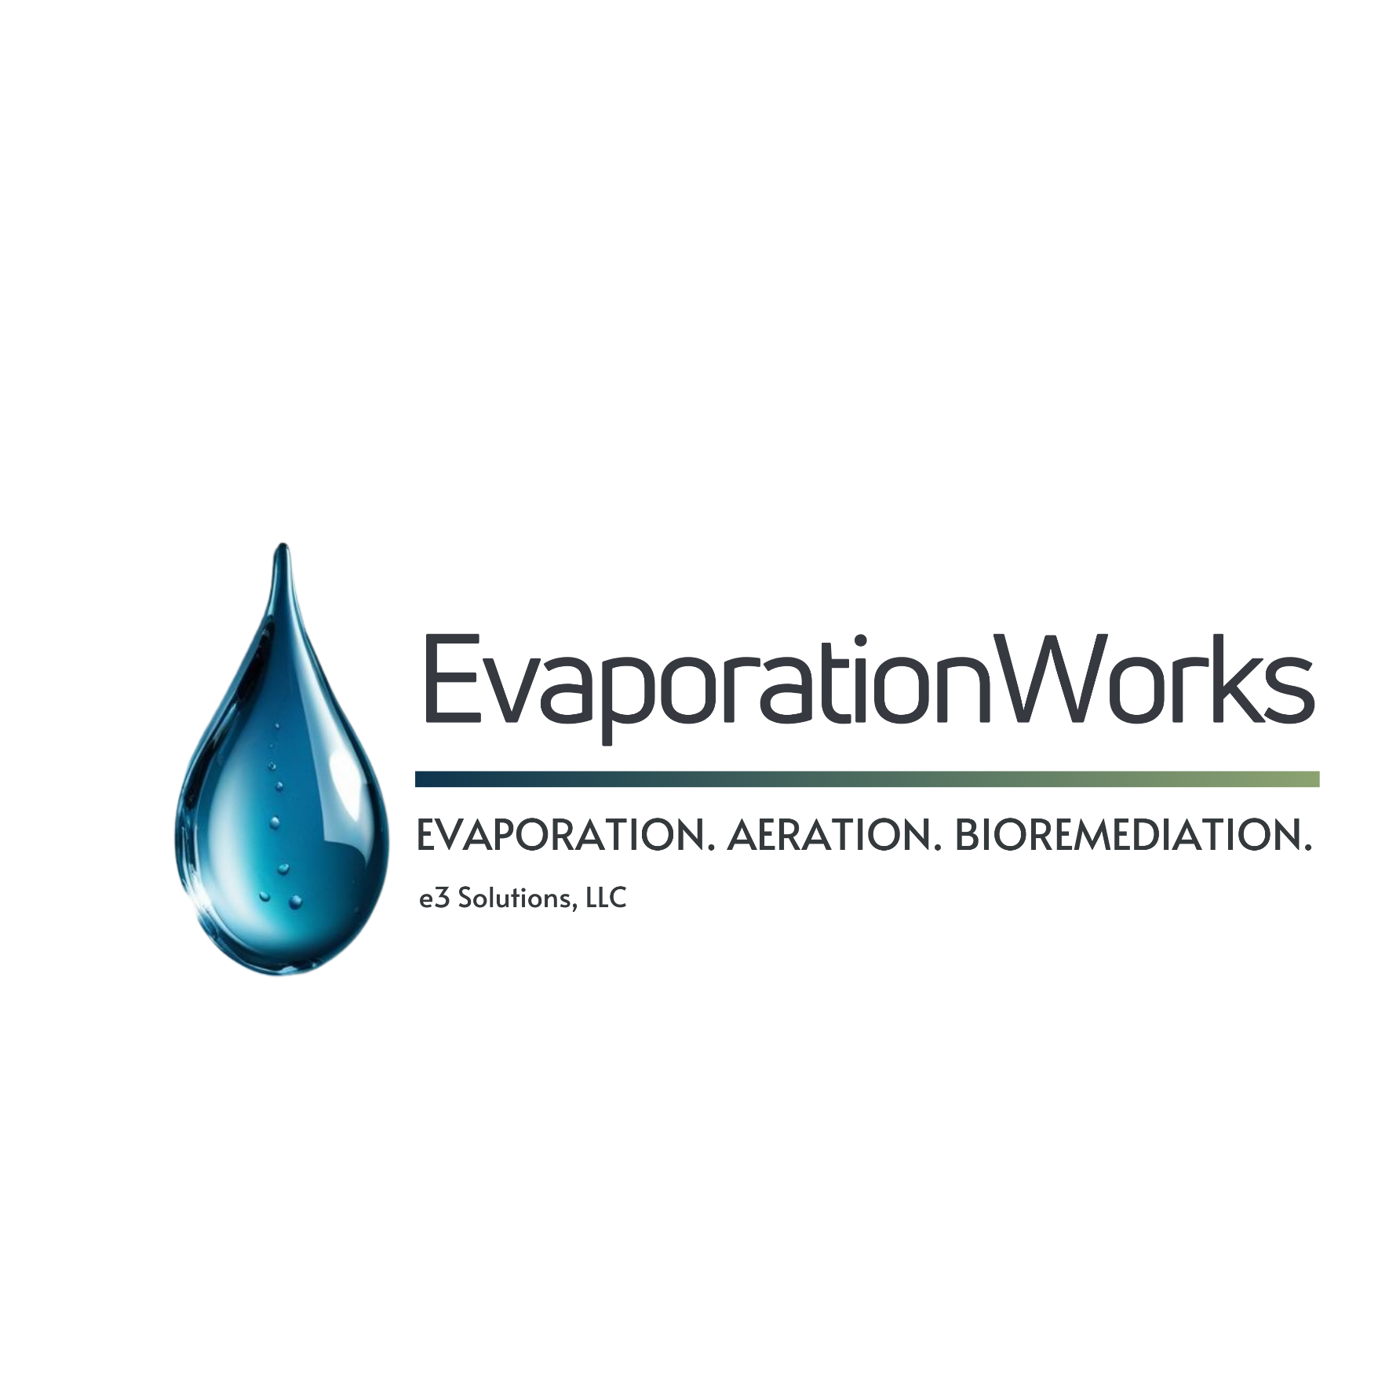
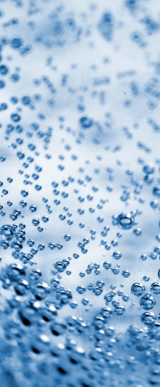
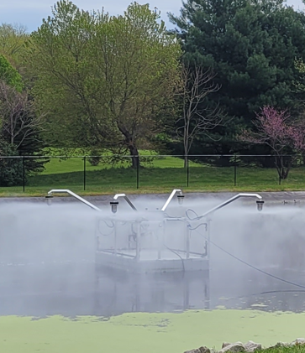
Fast Track Water Disposal

Slide 2
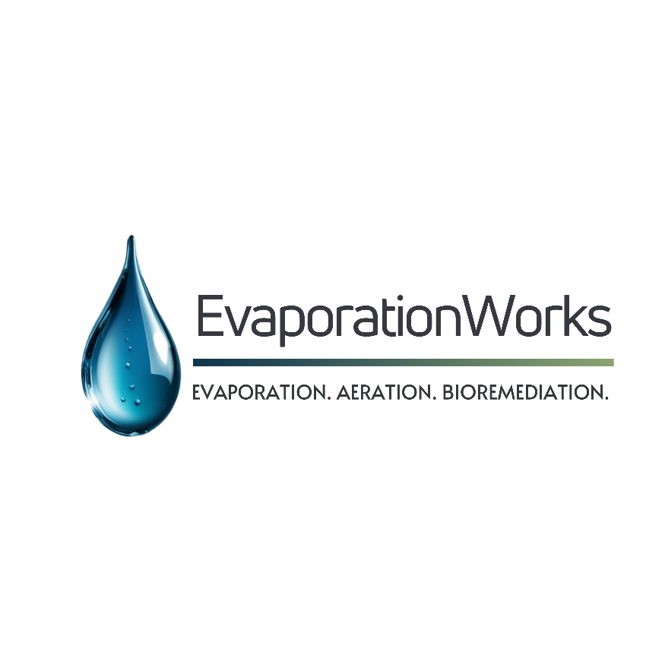
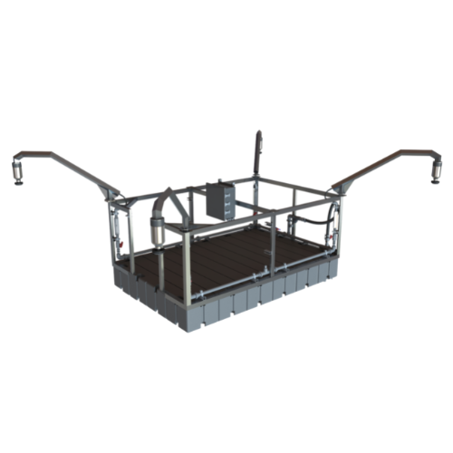
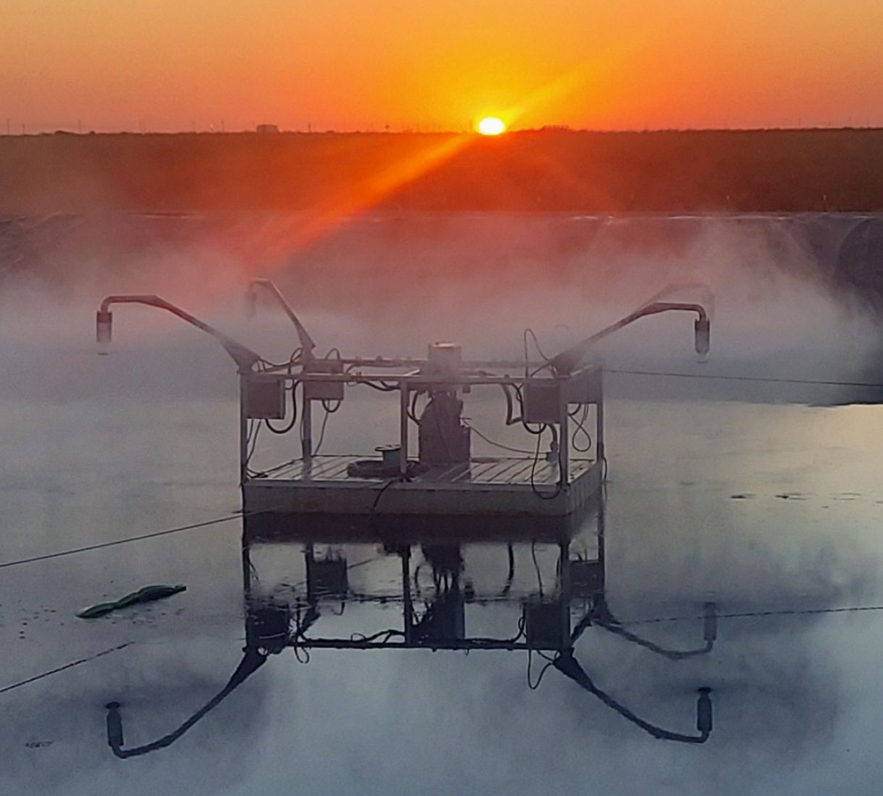
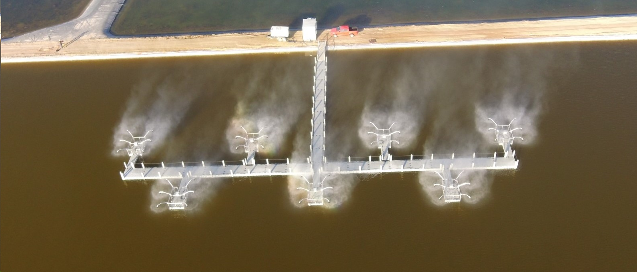
Varimax V- 40 Evaporation System
Phone: 1+-888-501-2026 Fast Track Water Disposal

Slide 3

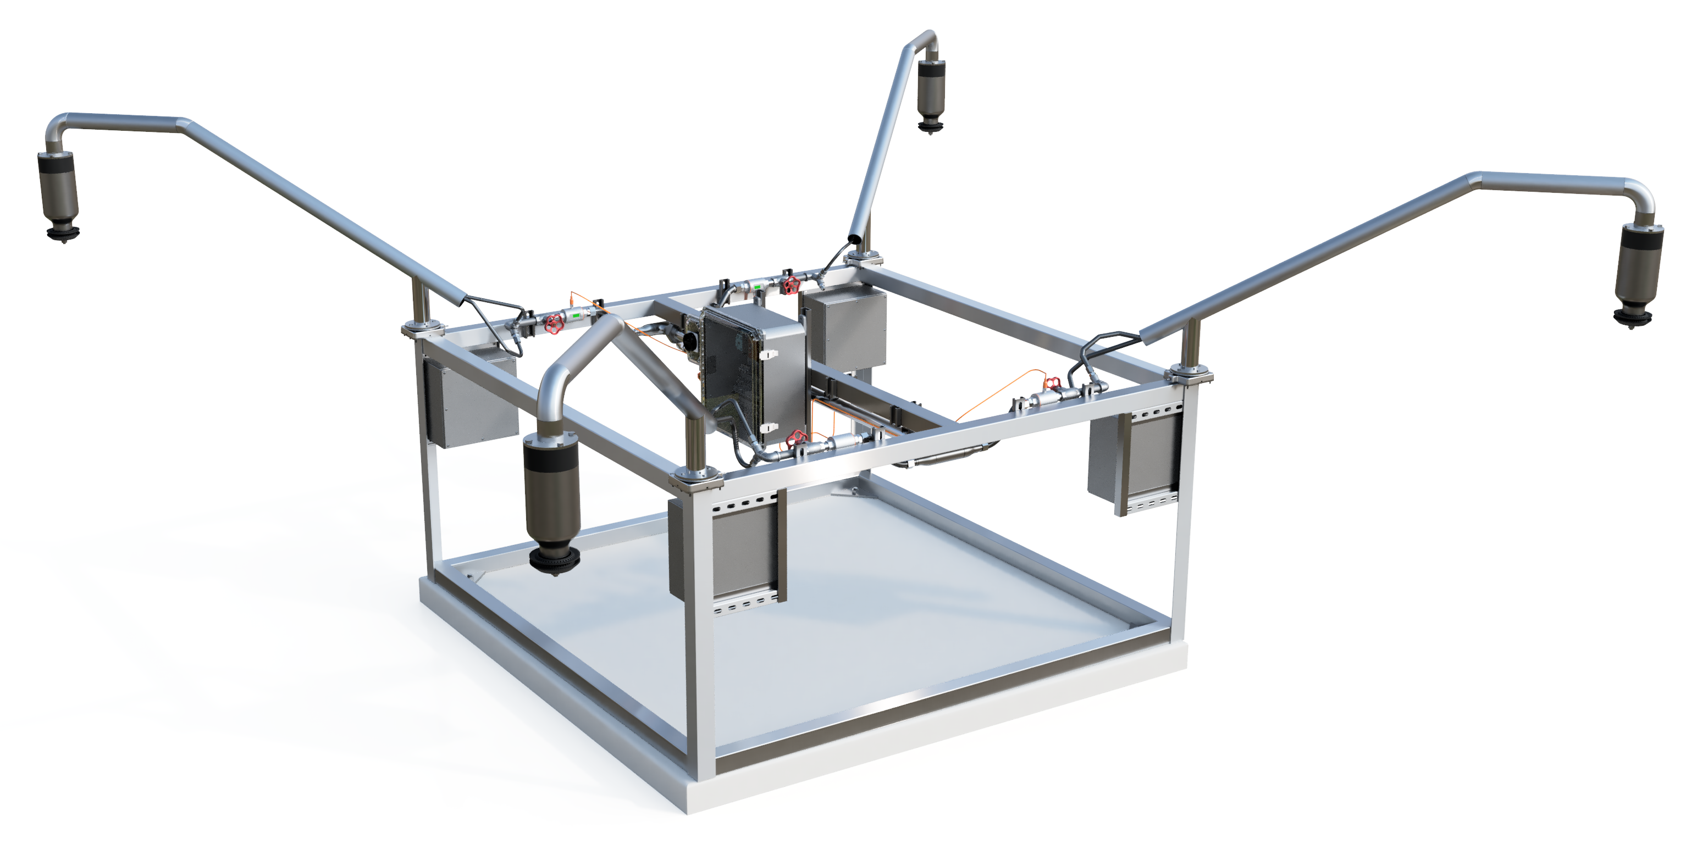
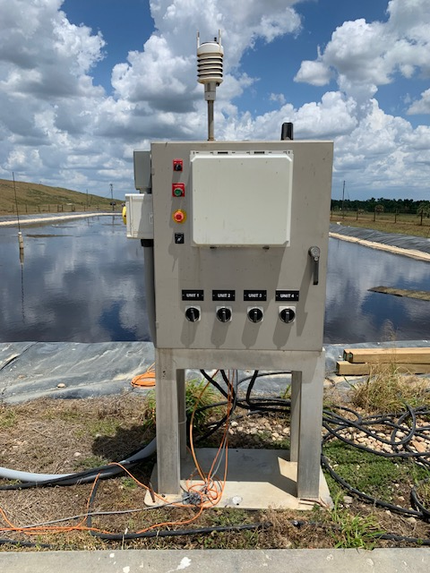
Portable Scalable Design
Phone: +1-888-501-2026 Fast Track Water Disposal

Slide 4
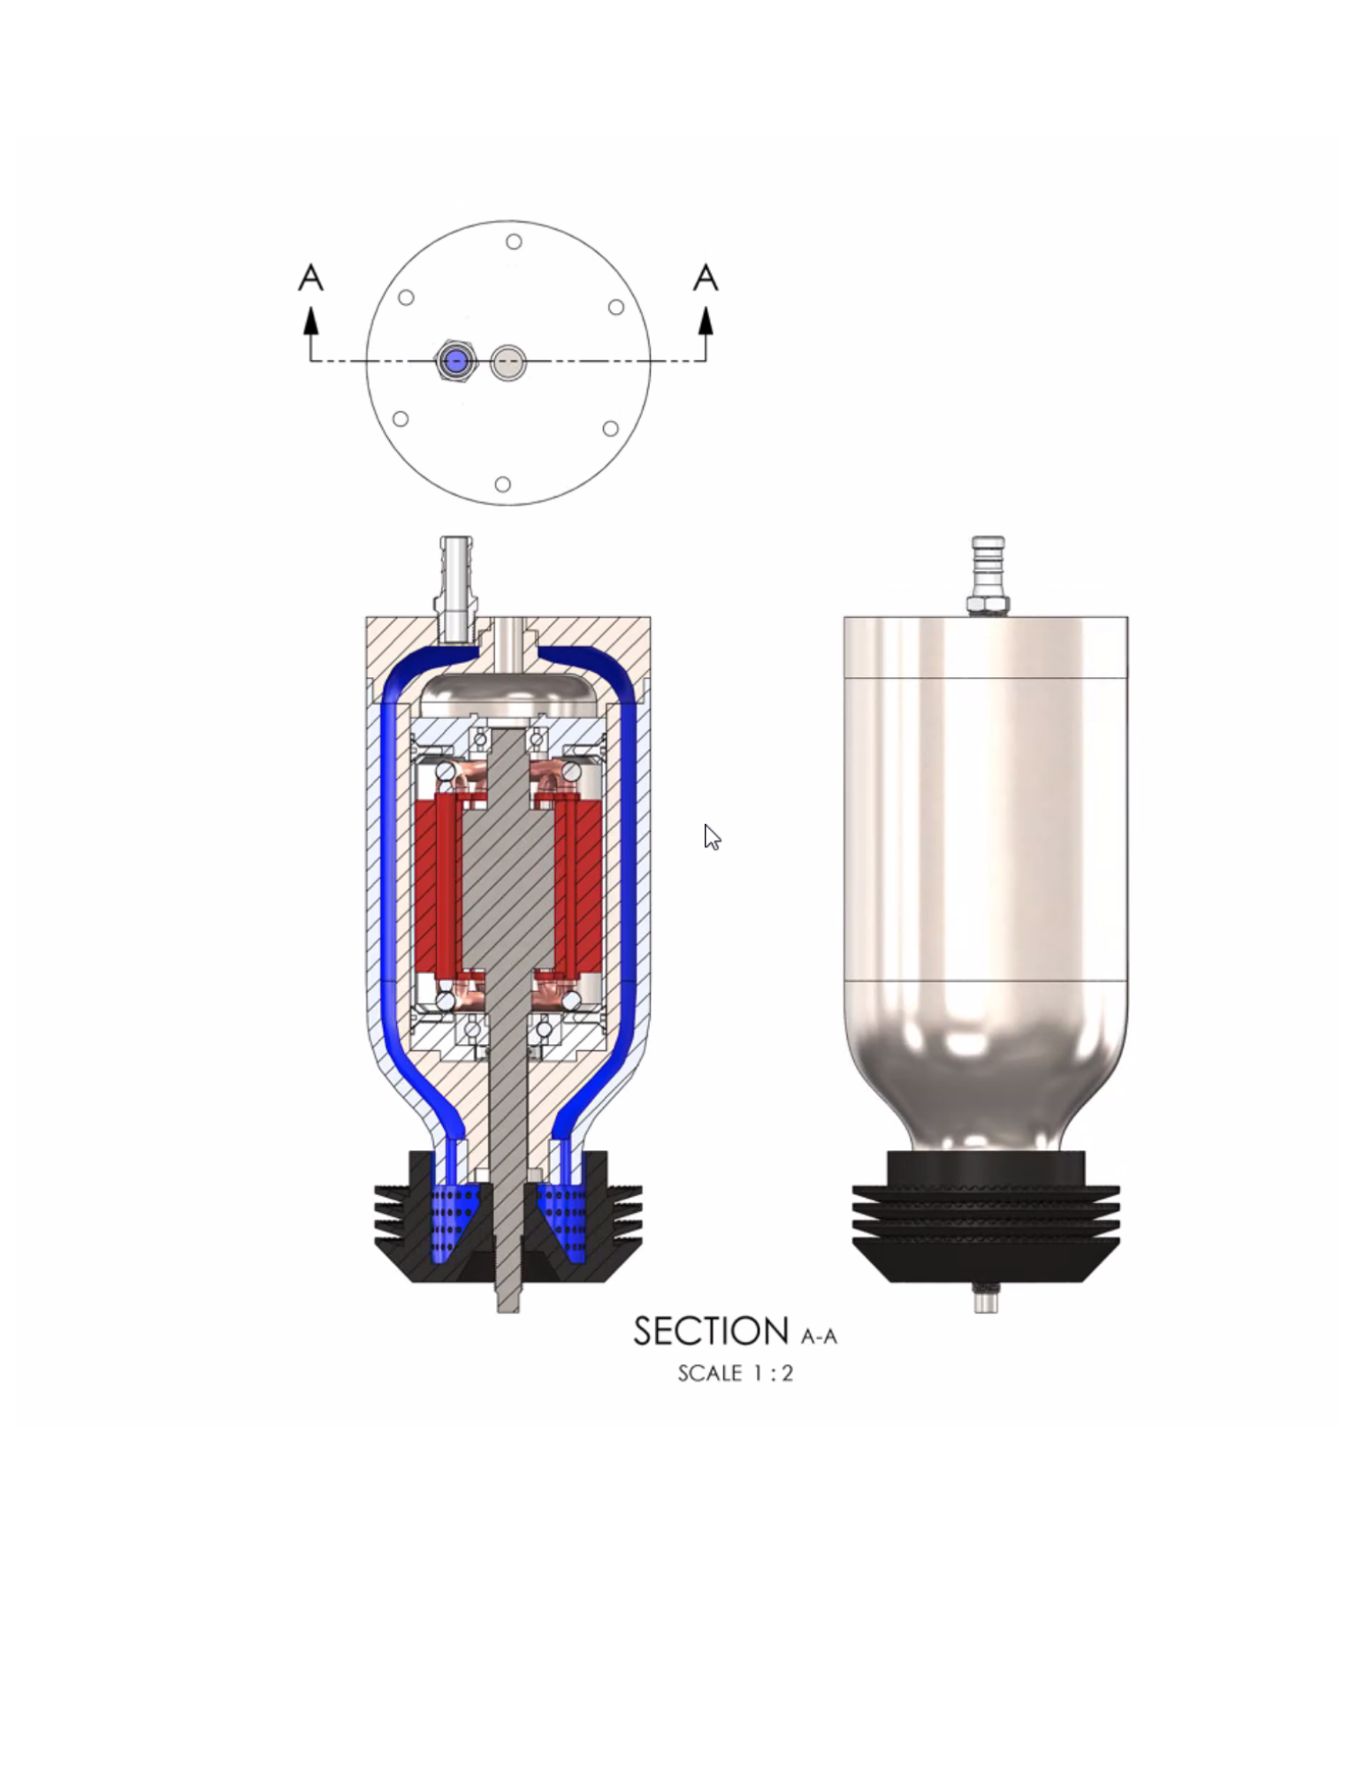
E3’s Superior Evaporation Technology
Rotary atomization for mechanical evaporation
Overspray control in real-time
Weather control interface for the highest efficiency
Highest evaporation efficiency-energy cost ratio on the market
Varimax V-40 Energy Efficiency and Performance
(4) 1.5 Hp Atomizer Motors each Varimax V-40
1100 BPD Throughput – 330 to 825 BPD Evaporation (30%-75%)
Phone: +1-888-501-2026 Fast Track Water Disposal

Slide 5
Project Application Considerations
Desired Daily Evaporation Rate
Local Climate
Dimensions of Pond or Lined Pad
Water Chemistry
Materials of Construction
Regulatory Requirements
Location of Critical Infrastructure near Pond or Pad
  Transformers, Power Lines, Controls, etc.
Phone: +1-888-501-2026 Fast Track Water Disposal

Slide 6
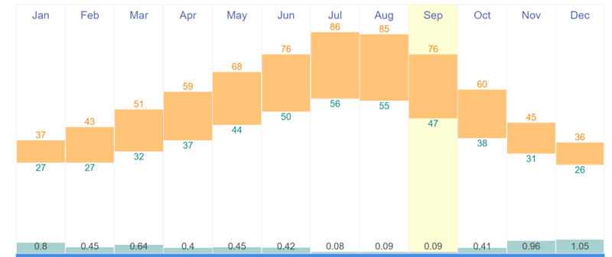
Data Driven Performance Modeling
Phone: 1+-888-501-2026 Fast Track Water Disposal

Slide 7
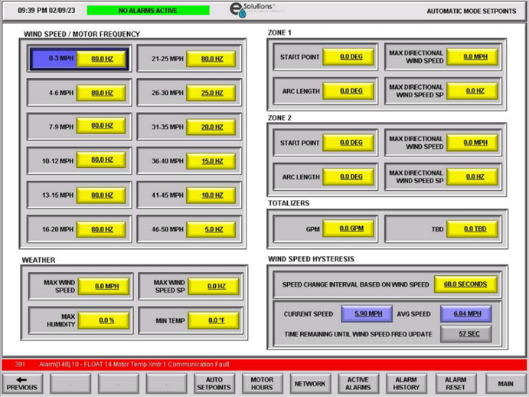
Overspray Protection Based on Wind Speed
Phone: +1-888-501-2026 Fast Track Water Disposal

Slide 8
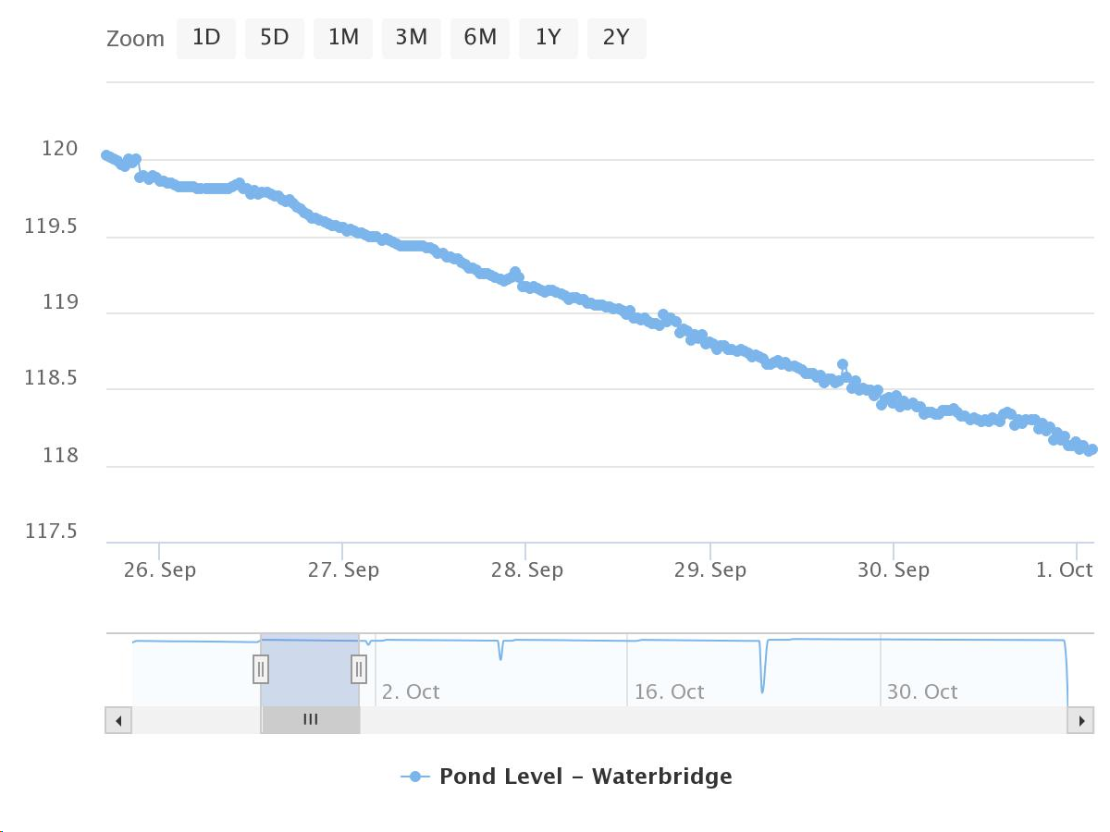
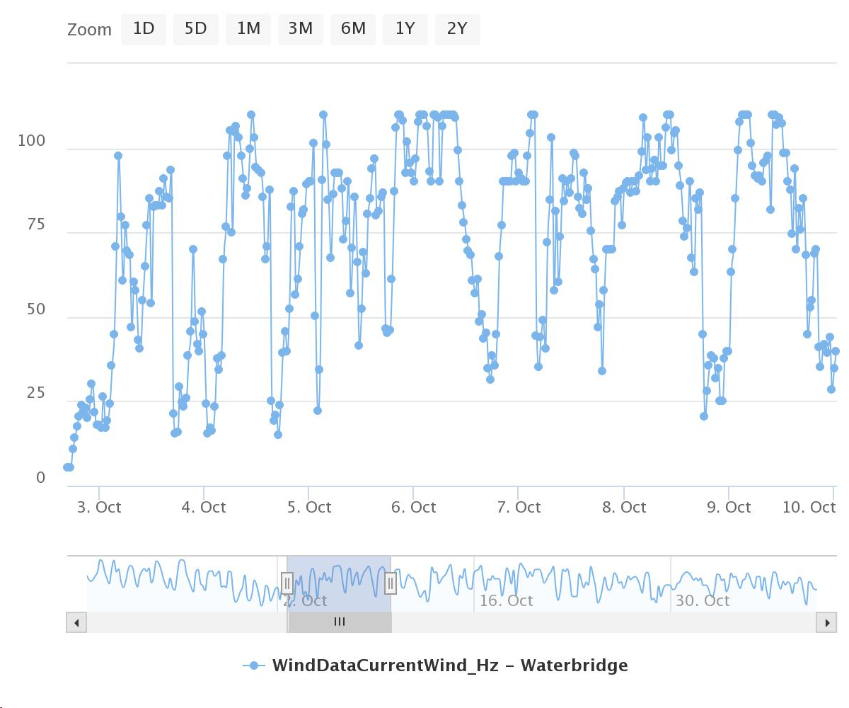
Data Collection and Remote Monitoring
Phone: +1-888-501-2026 Fast Track Water Disposal

Slide 9
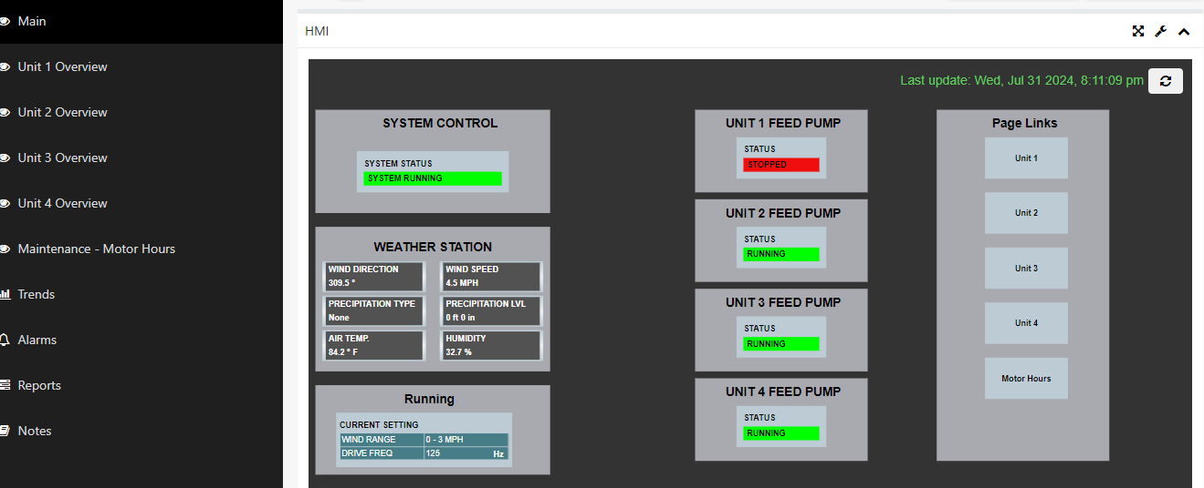
Remote System Monitoring
Phone: +1-888-501-2026 Fast Track Water Disposal

Slide 10
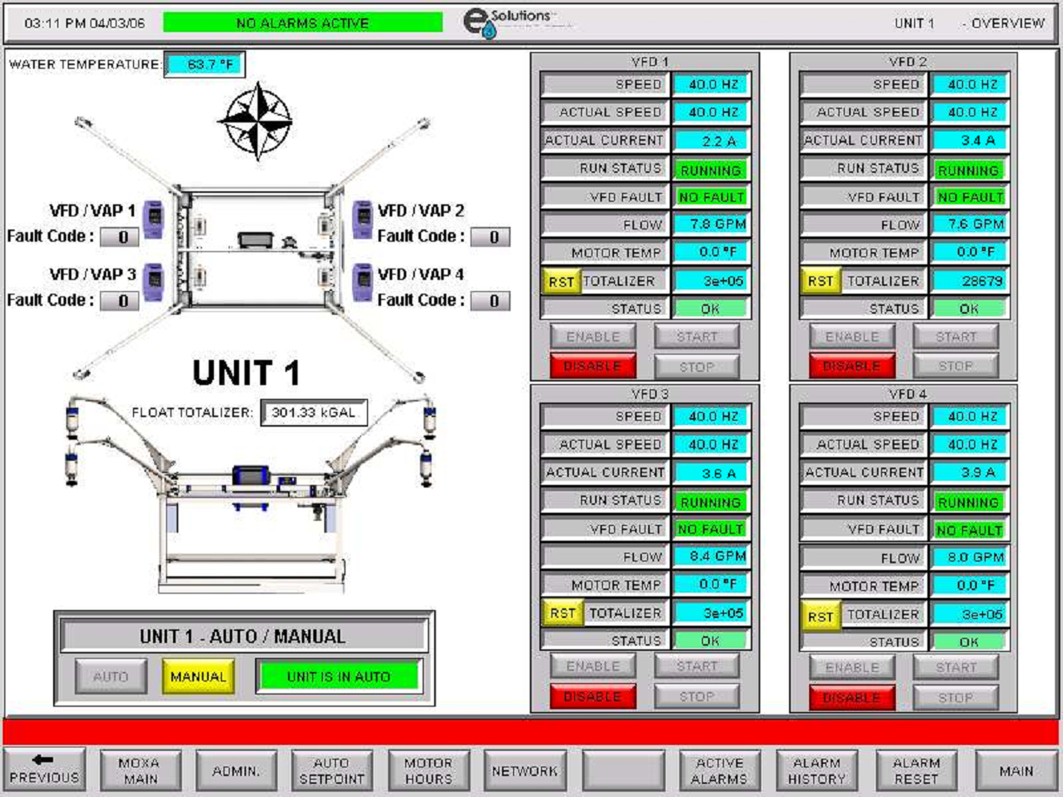
Remote HMI Access and Control
Phone: +1-888-501-2026 Fast Track Water Disposal

Slide 11
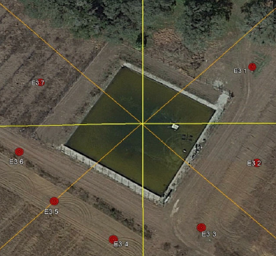
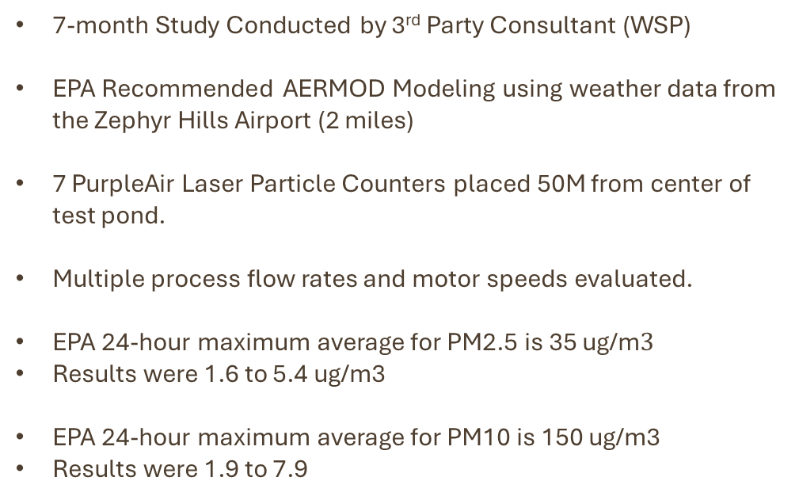
EPA National Ambient Air Quality Standards PM2.5 and PM10
7-month Study Conducted by 3rd Party Consultant (WSP)
EPA Recommended AERMOD Modeling using weather data from the Zephyr Hills Airport (2 miles)
7 PurpleAir Laser Particle Counters placed 50M from center of test pond.
Multiple process flow rates and motor speeds evaluated.
EPA 24-hour maximum average for PM2.5 is 35 ug/m$3$
Results were 1.6 to 5.4 ug/m3
EPA 24-hour maximum average for PM10 is 150 ug/m3
Results were 1.9 to 7.9
Phone: +1-888-501-2026 Fast Track Water Disposal

Slide 12
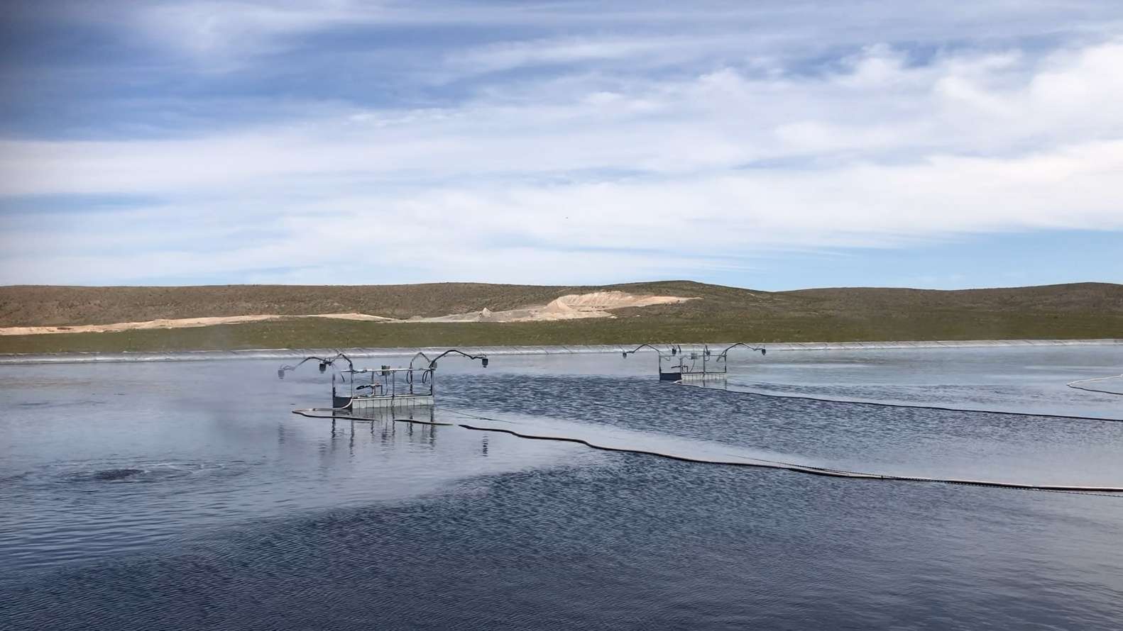
O&G Produced Water
The challenge – Rapid produced water accumulation and overflow events
Solution - Three Varimax V-40 units
Evaporation – Over 1,547 BPD
Benefits-
  Maximum overspray control capability
  Environmental compliance
  Evaporation efficiency exceeding 60%
Phone: +1-888-501-2026 Fast Track Water Disposal

Slide 13
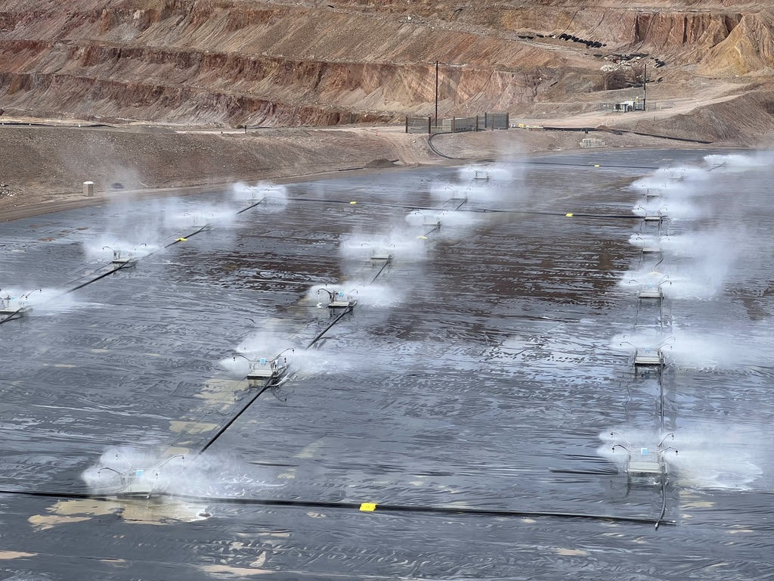
Mining Process Water
The challenge – Need to reduce volumes to maintain regulatory compliance.
Solution- Twenty-Five Varimax V-40 units
Evaporation – Over 20,000 BPD (>845K GPD) Throughput – 900 GPM, ~1.3M GPD
Benefits-
  Reliable processing of >250K TDS
  Reliable processing of <2.5 pH water
  Evaporation efficiency exceeding 75%
Phone: +1-888-501-2026 Fast Track Water Disposal

Slide 14
Robin Leiby Director of Marketing & Business Development 📱 +1 (813) 453-6415 🏢 +1 (813) 223-9000 🔗 Linkedin 🌐 www.evaporationworks.com |  | Ed Butler Project Development Manager 📱 +1 (281) 384-7955 🏢 +1 (813) 223-9000 🔗 Linkedin 🌐 www.evaporationworks.com
Phone: +1-888-501-2026 Fast Track Water Disposal

